Slide 2
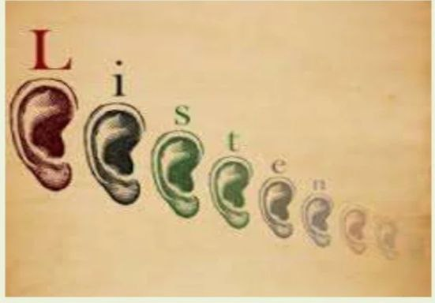
Listening Comprehension
By – Pratham darji

Slide 3
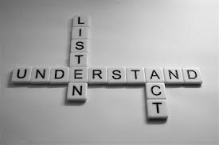
Meaning
Listening comprehension is more than just hearing what is said.
Listening is a process of receiving, constructing meaning from, and responding to spoken and/or non-verbal messages.
Listening is an Active process.

Slide 4

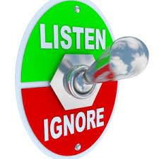

Basic Types Of Listening
Active Listening
Understands all things
Proper Interaction
Proper feedback
Selective Listening
We remember only selected portion
Topic not to our liking.
Ignoring Listening
Not listening to others at all.
Leads to Stained Relation.

Slide 5

Stages of Listening Process
Hearing
Focusing on message
Analyzing and Evaluating
Responding
Remembering

Slide 6
Myths About Listening
Listening is not my problem
Listening and hearing are same
Smarter people are better listeners
Good readers are good listeners
Listening improves with age and experience

Slide 7
Importance of Listening
To avoid communication errors
Helps to learn something new.
We display respect to others viewpoint.
It improves your personality.

Slide 8
Barriers to Effective Listening
Physical Barriers
Noise
Defected mechanical devices
Uncomfortable Environment
Psychological Barriers
Being unsure of the Speaker’s ability
Personal Anxiety
Attitude
Impatience

Slide 9
Why People Don’t Listening
People are distracted and preoccupied a full 75 percent of all time
We usually recall just 50 percent of what was said immediately after we talk
We just spend 45 percent of our time Listening.
We remember just 20 percent of what we hear.

Slide 10
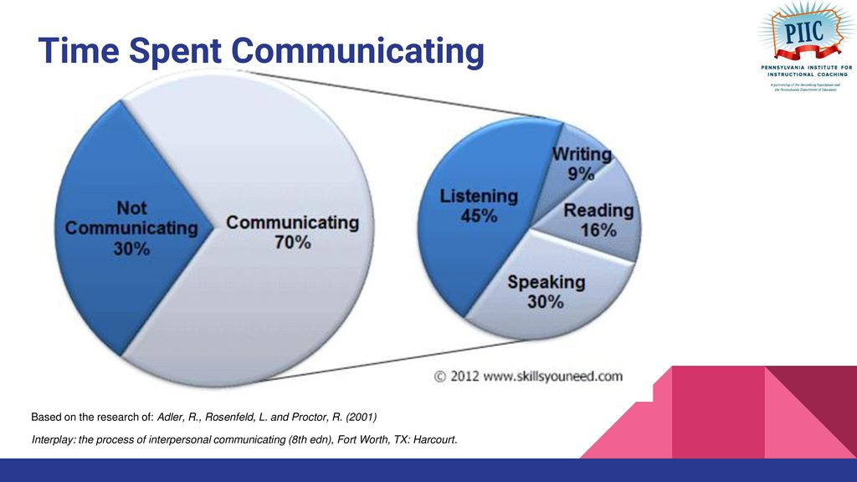
How to Listen Effectively
Stop Talking
Be Silent
Ask Questions
Maintain Eye Contact
Practice Listening
Show Interest
Wait and watch for Non-Verbal Communication

Slide 11

Thank you

